Slide 1
Digital Forensics Faked Speech Detection with Zero Knowledge
Submitted by: Anand Prakash Saini
13/12/2023
Original Paper by: Sahar Al Ajmi, Khizar Hayat, Alaa M. Al Obaidi, Naresh Kumar, Munaf Najmuldeen

Slide 2
Problem Statement:
Rise of AI & Digital Audio Technology
Rapid AI advancements have enabled the creation of realistic faked speech.
Emerging Risks
These developments pose risks like identity theft, misinformation spread, and security threats.
Critical Need
In today's digital era, ensuring the authenticity of audio content is crucial.

Slide 3
Introduction:
This research work introduces a neural network-based method to distinguish real from mimicked speech.
Without relying on any reference or real source audio.
'zero-knowledge' detection.
Leverages audio feature extraction techniques, including spectral and cepstral analyses,

Slide 4
Background:
Audio Vs Speech:
Audio is a waveform data in which the amplitude changes with respect to time.
Speech is the oral communication and pertains to the act of speaking and expressing thoughts and emotions by sounds and gestures.
Temporal and Spectral features:
Temporal: Time domain features having simple physical interpretation and easy to compute.
Examples: Signal’s energy, maximum amplitude, zero crossing rate, minimum energy etc.
Spectral: Frequency-based features that are extracted after passing the time domain signal to the frequency domain using Fourier or other similar transforms.
Examples: Centroid, spectral flux, spectral density, roll-off etc.
Spectrum and cepstrum
Spectrum : Fourier transform of a signal i.e. spectrum is the audio signal in frequency domain.
Cepstrum is the log of the magnitude of the spectrum followed by an inverse Fourier transform. That’s why its domain is neither frequency nor the time; its domain is called quefrency.
Notes:
Audio Vs Speech:
Audio is a waveform data in which the amplitude changes with respect to time.
Speech is the oral communication and pertains to the act of speaking and expressing thoughts and emotions by sounds and gestures.
Temporal and Spectral features:
The Temporal features: Time domain features having simple physical interpretation and easy to compute.
Examples are signal’s energy, maximum amplitude, zero crossing rate, minimum energy etc.
The spectral features: Frequency-based features that are extracted after passing the time domain signal to the frequency domain using Fourier or other similar transforms.
Examples are frequency components, fundamental frequency, centroid, spectral flux, spectral density, roll-off etc.
Spectrum and cepstrum are two important frequency-based concepts in audio processing:
A spectrum : Fourier transform of a signal which converts a time-domain signal into frequency domain, i.e. spectrum is the audio signal in frequency domain.
A cepstrum is the log of the magnitude of the spectrum followed by an inverse Fourier transform. That’s why its domain is neither frequency nor the time; its domain is called quefrency

Slide 5

Data:
Collected from a number of social media apps and sites.
Limited to a maximum duration of 20 seconds in WAV format.
One part of the dataset consists of all English audios, the second part of the dataset contains a mix of both English and Arabic audios.
Our goal is to blindly identify whether a given voice is mimicked or otherwise.
Real and faked voices uttered independently of what is being said and who said it and independent of the language.
Real Audio Example:
Fake Audio Example:

Slide 6
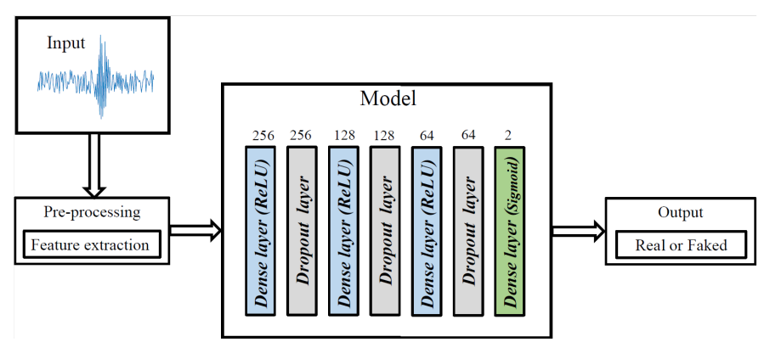
Methodology:

Slide 7
Methodology:
Network trained on English only Data.
Performance of English only model on Arabic Audios
Further training with mixed data
Any Improvement/ Language has any role?

Slide 8
Methodology: Input
Input:
For the training set, it is essential that:
Exactly one sample pertains to a purported speaker.
Either the real or the faked voice of a given speaker is part of the dataset.
The spoken words are not required to be identical.
Keeping the above in view, We extracted our dataset from the raw dataset to contain 933 English-only audio samples and 1127 samples in both English and Arabic.

Slide 9
Methodology: Feature Extraction
Model works on extracting features using LIBROSA Python Package, 26 features extracted are:
Root Mean Square Energy (RMSE): Loudness.
Zero crossing rate: Number of times the value of the signal changes between positive and negative
Spectral centroid: Center of mass.
Spectral bandwidth: Difference between the higher and lower frequencies.
Spectral roll off : Differentiate between the harmonic sound (below roll off) and the noise sound (above roll off).
Chroma: The spectrum is divided onto 12 bins representing the 12 distinct semitones of the musical octave.
20 Mel Frequency Cepstral Coefficients (MFCCs): Perceived pitch, applying a short time Fourier transform to window-based slices, then calculating the power spectrum and consequently filter banks (triangular in shape).
Notes:
Zero crossing rate: number of times the value of the signal changes between positive and negative and vise versa
Spectral centroid: frequency which indicates the location of the center of mass of the spectrum.
Spectral roll off: Differentiate between the harmonic sound (below roll off) and the noise sound (above roll off) (85% by default).
Spectral bandwidth: The difference between the higher and lower frequencies in a group of continuous frequencies.
Chroma: This representation for audio where the spectrum is divided onto 12 bins representing the 12 distinct semitones (or chroma) of the musical octave.
Root Mean Square Energy (RMSE): Energy of the signal, and shows how loud the signal is.
Spectral flux: It measures how quick the power spectrum of a signal is changing, and it is calculated by comparing the changes of the power spectrum between one frame and the frame before it.
Spectral density: It is the measure of signal’s power content against frequency.
Cepstral Features: These are, as stated above, quefrency domain features with the following being considered important:
Mel Frequency Cepstral Coefficients (MFCCs):

Slide 10
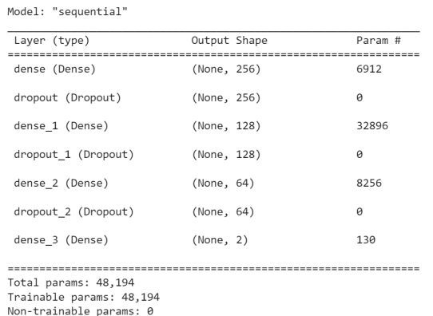
Methodology: Neural Network Model
Optimizer: ADAM (Adaptive Moment Estimation)
Loss Function: Sparse Categorical cross entropy
Epochs: 140
Batch-Size = 128
Learning rate = 0.0003

Slide 11
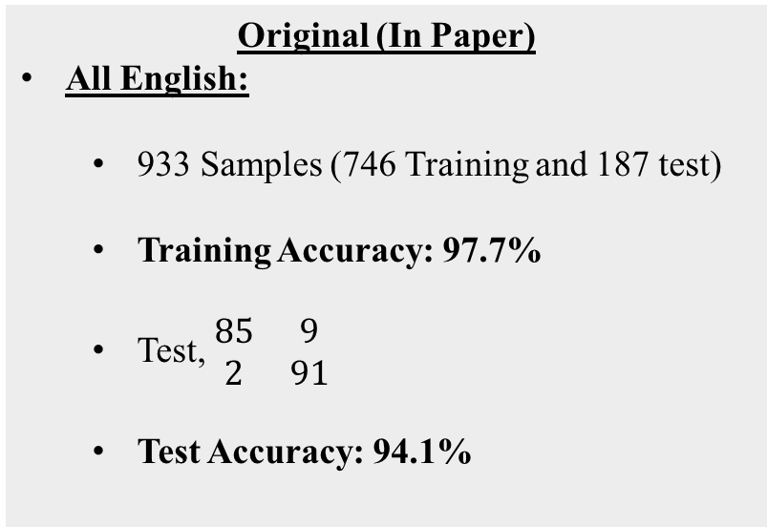
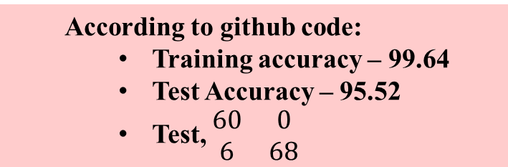
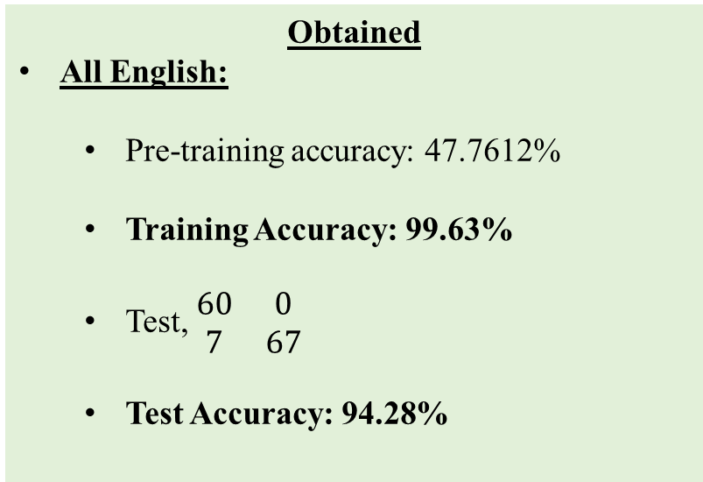
Results: Comparison
Original (In Paper)
All English:
933 Samples (746 Training and 187 test)
Training Accuracy: 97.7%
Test, $\begin{matrix}85 & 9 \\ 2 & 91\end{matrix}$
Test Accuracy: 94.1%
Obtained
All English:
Pre-training accuracy: 47.7612%
Training Accuracy: 99.63%
Test, $\begin{matrix}60 & 0 \\ 7 & 67\end{matrix}$
Test Accuracy: 94.28%
According to github code:
Training accuracy – 99.64
Test Accuracy – 95.52
Test, $\begin{matrix}60 & 0 \\ 6 & 68\end{matrix}$

Slide 12
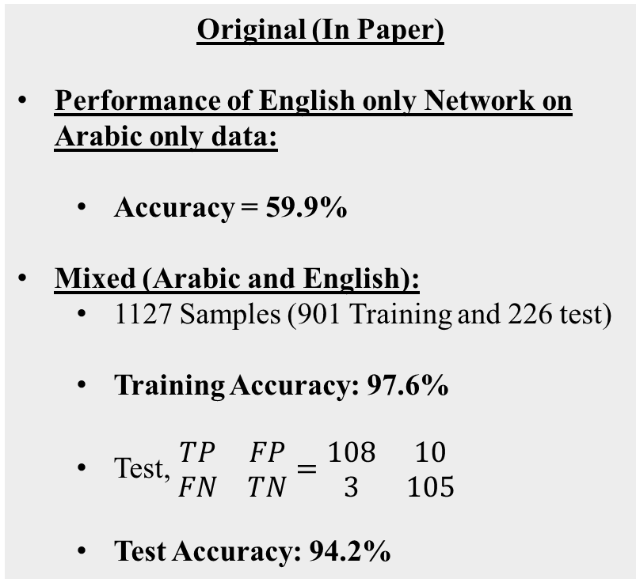
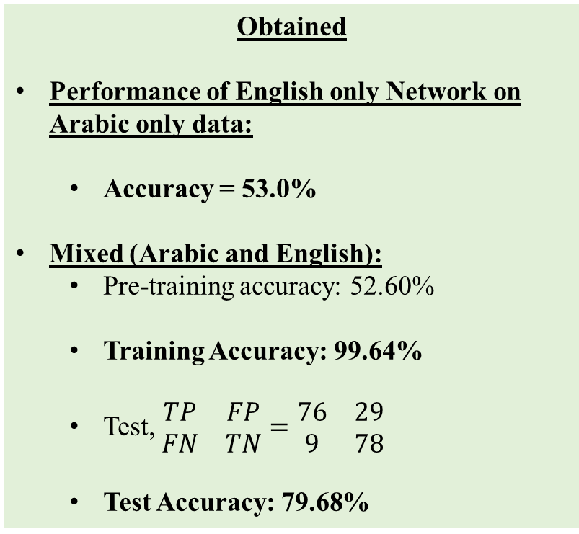
Results: Comparison
Original (In Paper)
Performance of English only Network on Arabic only data:
Accuracy = 59.9%
Mixed (Arabic and English):
1127 Samples (901 Training and 226 test)
Training Accuracy: 97.6%
Test, $\begin{matrix}TP & FP \\ FN & TN\end{matrix}=\begin{matrix}108 & 10 \\ 3 & 105\end{matrix}$
Test Accuracy: 94.2%
Obtained
Performance of English only Network on Arabic only data:
Accuracy = 53.0%
Mixed (Arabic and English):
Pre-training accuracy: 52.60%
Training Accuracy: 99.64%
Test, $\begin{matrix}TP & FP \\ FN & TN\end{matrix}=\begin{matrix}76 & 29 \\ 9 & 78\end{matrix}$
Test Accuracy: 79.68%
No Code is provided on github for inspection of mixed data.

Slide 13
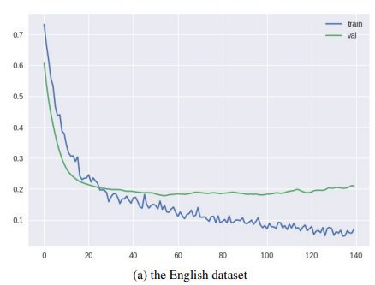
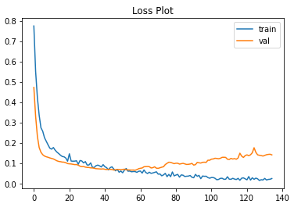
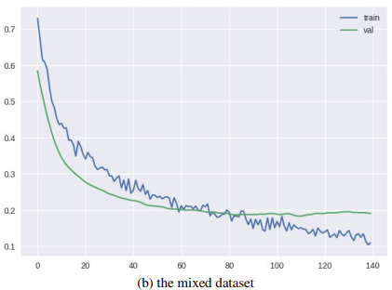
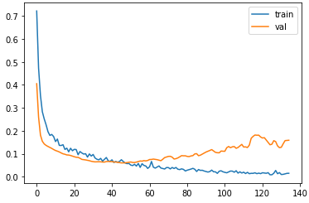
Results: Comparison
Original (In Paper)
Obtained
Loss
Loss
Epochs
Epochs
Loss
Loss
Epochs
Epochs

Slide 14
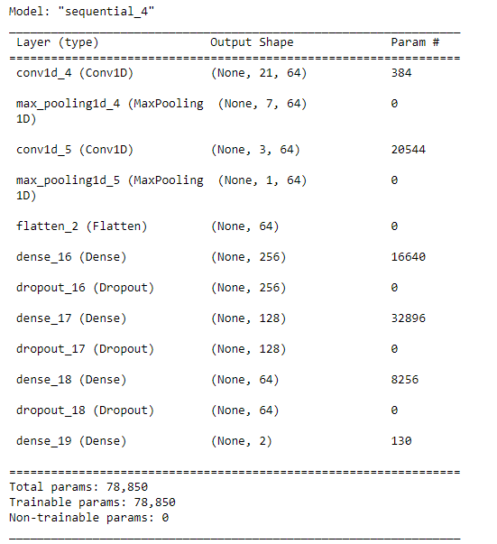
Results: Further experiments
Adding CNN:
CNNs are highly effective in capturing local patterns in data.
It can efficiently recognize patterns in spectral features and MFCCs, which are critical for distinguishing real from faked speech.
Reduced epochs to 60.
Performance:
Pre-training accuracy: 39.06%
Training Accuracy: 99.63%
Testing Accuracy: 82.30%

Slide 15
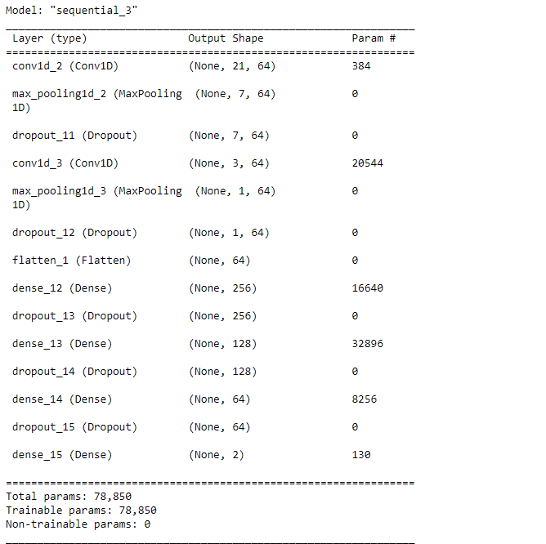
Results: Further experiments
To Avoid overfitting:
Increased Dropout Rate: The dropout rate has been increased to 0.6 after each convolutional and dense layer.
L2 Regularization: Added L2 regularization to convolutional and dense layers, which penalizes large weights.
Early Stopping: An early stopping callback is set to monitor validation loss and will stop training if the loss does not decrease for 5 consecutive epochs.
Performance:
Pre-training accuracy: 54.68%
Training Accuracy: 96.08%
Testing Accuracy: 77.08%

Slide 16
Conclusion
The system can classify a given speech as faked or otherwise on the fly given no information about the speaker.
we were able to deduce that the nature of spoken language may be important as we got less that 60% accuracy in classifying via a network trained by English-only samples.
Accuracy improved when the network was trained on mix data, Arabic constituted approximate 18 − 20% of the dataset. The performance of our model is proven by its accuracy which was at least 75%.
Further attempts were made to improve the performance by using more sophisticated networks such as CNN.
Dropout, regularization and early stopping techniques were applied to reduce overfitting.

Slide 17
Bibliography
https://arxiv.org/pdf/2209.12573v5.pdf
https://github.com/SaSs7/Dataset/blob/main/speakers%20(1).ipynb
https://librosa.org/doc/latest/index.html

